Slide 1

Computer Organization And Architecture
CSE-209
Lecture – 05+06
Al Bashir
Lecturer, Dept. of CSE
Dhaka International University

Slide 2
Content
Computer Memory System Overview
Cache Memory Principles
Elements of Cache Design

Slide 3
Computer memory
In computing, memory refers to the computer hardware integrated circuits that store information for immediate use in a computer; it is synonymous with the term "primary storage".
Computer memory operates at a high speed, for example random-access memory (RAM), as a distinction from storage that provides slow-to-access information but offers higher capacities. If needed, contents of the computer memory can be transferred to secondary storage, through a memory management technique called "virtual memory".
-- Wikipedia

Slide 4
Computer memory
Key Characteristics of Computer Memory Systems
Location
Internal (e.g. processor registers, main memory, cache)
External (e.g. optical disks, magnetic disks, tapes)
Capacity
Number of words
Number of bytes
Unit of Transfer
Word
Block
Access Method
Sequential
Direct
Random
Associative

Slide 5
Computer memory
Key Characteristics of Computer Memory Systems
Performance
Access time
Cycle time
Transfer rate
Physical Type
Semiconductor
Magnetic
Optical
Magneto-optical
Physical Characteristics
Volatile/nonvolatile
Erasable/nonerasable
Organization
Memory modules

Slide 6
Computer memory
Another definition is:
Computer memory is any physical device capable of storing information temporarily or permanently.

Slide 7
The Memory Hierarchy
The design constraints on a computer’s memory can be summed up by three questions:
How much?
How fast?
How expensive?
As might be expected, there is a trade-off among the three key characteristics of memory: namely- capacity, access time, and cost.
• Faster access time, greater cost per bit
• Greater capacity, smaller cost per bit
• Greater capacity, slower access time

Slide 8
The Memory Hierarchy
A typical hierarchy is illustrated in following Fig. As one goes down the hierarchy, the following occur:
Decreasing cost per bit
Increasing capacity
Increasing access time
Decreasing frequency of access of the memory by the processor

Slide 9
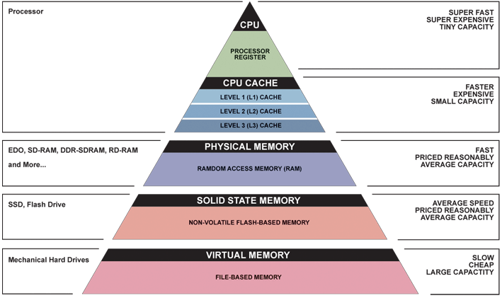
Memory Hierarchy - Diagram

Slide 10
Memory Hierarchy
Registers
In CPU
Internal or Main memory
May include one or more levels of cache
“RAM”
External memory
Backing store

Slide 11
Hierarchy List
Registers
L1 Cache
L2 Cache
L3 Cache
Main memory
Disk cache
Disk
Optical
Tape

Slide 12
Cache Memory
As CPU has to fetch instruction from main memory speed of CPU depending on fetching speed from main memory. CPU contains register which has fastest access but they are limited in number as well as costly. Cache is cheaper so we can access cache. Cache memory is a very high speed memory that is placed between the CPU and main memory, to operate at the speed of the CPU.
It is used to reduce the average time to access data from the main memory. The cache is a smaller and faster memory which stores copies of the data from frequently used main memory locations.

Slide 13
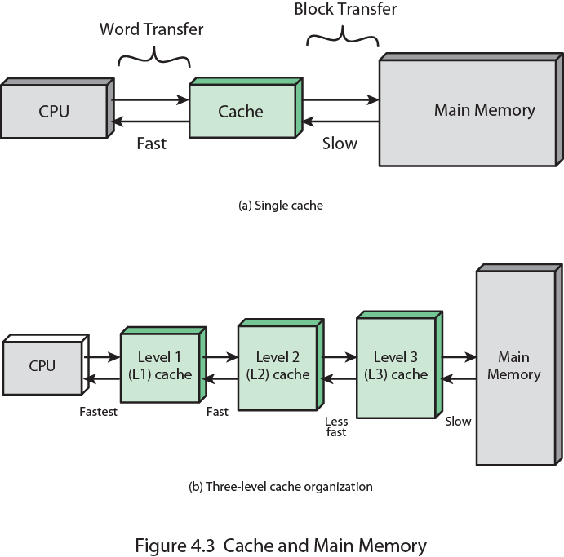
Cache and Main Memory

Slide 14
Why Cache Memory?
There is a relatively large and slow main memory together with a smaller, faster cache memory. The cache contains a copy of portions of main memory.
When the processor attempts to read a word of memory, a check is made to determine if the word is in the cache. If so, the word is delivered to the processor.
If not, a block of main memory, consisting of some fixed number of words, is read into the cache and then the word is delivered to the processor.

Slide 15
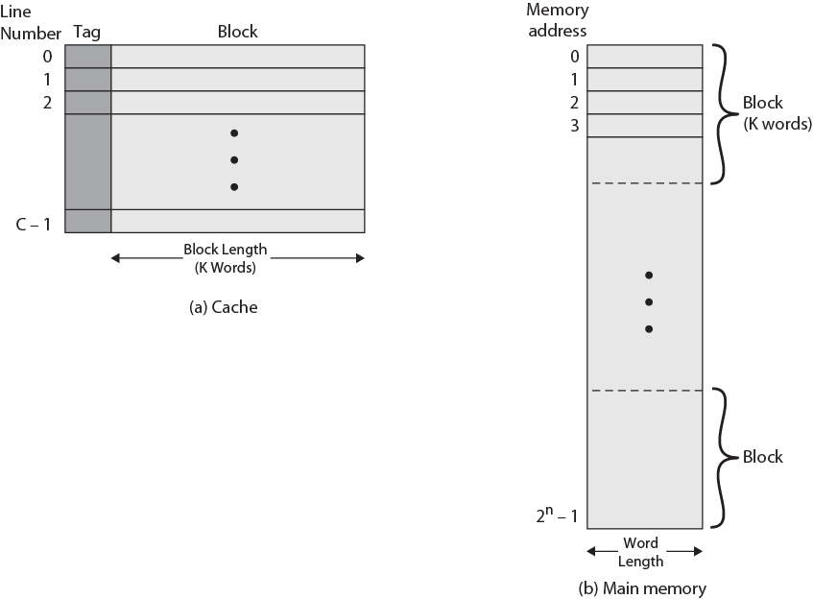
Cache/Main Memory Structure

Slide 16
Cache/Main Memory Structure
Main memory consists of up to 2^{n} addressable words, with each word having a unique n-bit address.
For mapping purposes, this memory is considered to consist of a number of fixed length blocks of K words each. That is, there are M=2^{n}/K blocks in main memory.
The cache consists of m blocks, called lines[1]. Each line contains K words, plus a tag of a few bits.
[1]In referring to the basic unit of the cache, the term line is used, rather than the term block, for two reasons:
to avoid confusion with a main memory block, which contains the same number of data words as a cache line; and
(2) because a cache line includes not only K words of data, just as a main memory block, but also include tag and control bits.

Slide 17
Cache Read Operation
The processor generates the read address (RA) of a word to be read.
If the word is contained in the cache, it is delivered to the processor.
Otherwise, the block containing that word is loaded into the cache, and the word is delivered to the processor.

Slide 18
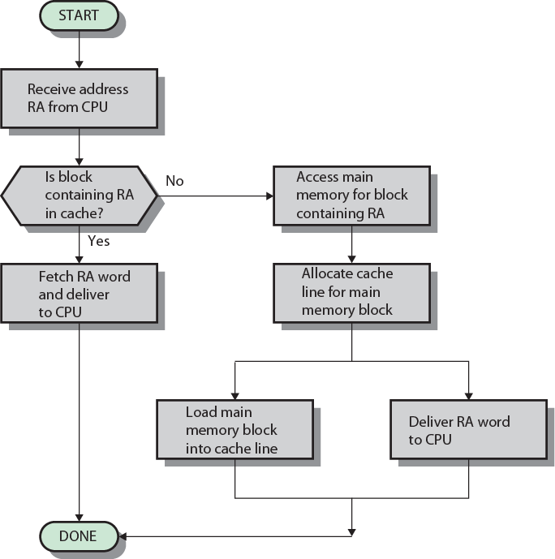
Cache Read Operation - Flowchart

Slide 19
Cache Organizations
The cache connects to the processor via data, control, and address lines.
The data and address lines also attach to data and address buffers, which attach to a system bus from which main memory is reached.
When a cache hit occurs, the data and address buffers are disabled and communication is only between processor and cache, with no system bus traffic.
When a cache miss occurs, the desired address is loaded onto the system bus and the data are returned through the data buffer to both the cache and the processor.

Slide 20
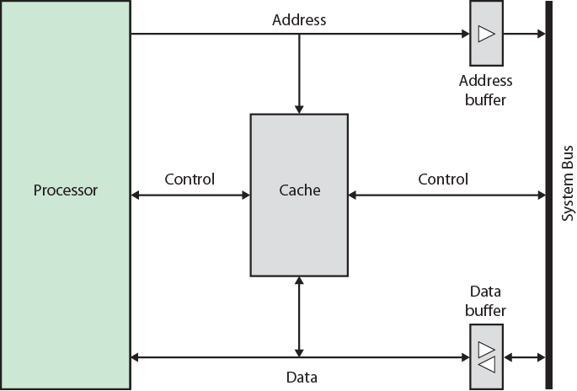
Cache Organizations
.

Slide 21
Elements of Cache Design
Cache Addresses
Logical
Physical
Cache Size
Mapping Function
Direct
Associative
Set Associative
Replacement Algorithm
Least recently used (LRU)
First in first out (FIFO)
Least frequently used (LFU)
Random

Slide 22
Elements of Cache Design cont…
Write Policy
Write through
Write back
Write once
Line Size
Number of caches
Single, two or more level
Unified or split

Slide 23
Mapping Function
Because there are fewer cache lines than main memory blocks, an algorithm is needed for mapping main memory blocks into cache lines.
Further, a means is needed for determining which main memory block currently occupies a cache line.
Three techniques can be used:
Direct
Associative and
Set associative

Slide 24
Direct Mapping
The simplest technique, known as direct mapping, maps each block of main memory into only one possible cache line.
The mapping is expressed as-
i = j modulo m
where
i = cache line number
j = main memory block number
m = number of lines in the cache

Slide 25
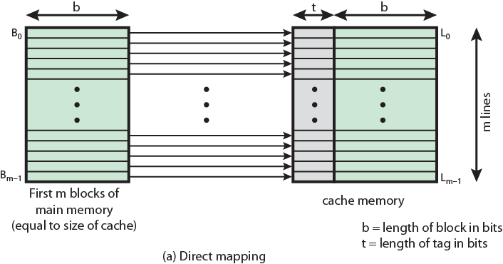
Direct Mapping
Figure shows the mapping for the first m blocks of main memory. Each block of main memory maps into one unique line of the cache.

Slide 26
Direct Mapping : Cache Line Table
The next m blocks of main memory map into the cache in the same fashion; that is, block B_{m} of main memory maps into line L₀ of cache, block B_{m1} maps into line L₁, and so on.
i = j modulo m
Cache line | Main Memory blocks held
0 | 0, m, 2m, 3m…2^{s}-m
1 | 1,m+1, 2m+1…2^{s}-m+1
…
m-1 | m-1, 2m-1,3m-1…2^{s}-1

Slide 27
Question??

Slide 28
Thanks

